Slide 1
CT Dose Notifications and Alerts
What are they, how do they work, and important information for successful implementation
April 16, 2014

Slide 2
Disclaimer
The information contained herein is current as of the date shown on the title slide
Not all systems may behave the same, or as shown in these examples. Users must understand the specific behavior of their specific CT system.
Questions should be directed to the respective manufacturer.
Modification of the content of these slides is allowed.
The modified content, including indirect or unintentional changes in the accuracy or meaning of related content, becomes the sole responsibility of the person/organization creating and/or using the edited version.
Neither the AAPM nor the manufacturers participating in creating this slide set assume any responsibility for edited versions of these slides, or for content of oral presentations associated with the original or edited slides.

Slide 3
Dose Notification Values
Used to trigger a message when a single planned and confirmed scan is likely to exceed a pre-programmed value (CTDIvol and/or DLP).
Programmed value is set for each scan sequence in an exam
Values can be adjusted according to user preference
Recommendations by the AAPM provide initial default values (for CTDIvol only)¹
Values were set by AAPM so that notifications would be infrequent to ensure that operators pay attention to them
If they pop up all the time, they will be ignored
Target frequency was approximately 5%
¹http://www.aapm.org/pubs/CTProtocols/documents/NotificationLevelsStatement.pdf

Slide 4
CT Scan Region (associated with one scan series or scan phase) | CTDIvol Notification Value (mGy)
Adult Head | 80
Adult Torso | 50
Pediatric Head <2 years old 2 – 5 years old | 50 60
Pediatric Torso <10 years old (16-cm phantom; GE, Hitachi, Toshiba) <10 years old (32-cm phantom; Siemens, Philips) | 25 10
Brain Perfusion (exam series that repeatedly scans same anatomic level to measure flow of contrast media through the anatomy) | 600
Cardiac Retrospectively gated (spiral) Prospectively gated (sequential) | 150 50
Source: http://www.aapm.org/pubs/CTProtocols/documents/NotificationLevelsStatement.pdf
Notes:
ª As of January 2011, GE, Hitachi and Toshiba scanners use the 16-cm-diameter CTDI phantom as the basis for evaluating dose indices (CTDIvol and DLP) displayed and reported for pediatric body examinations.
^{b} As of January 2011, Siemens and Philips scanners use the 32-cm-diameter CTDI phantom as the basis for evaluating dose indices (CTDIvol and DLP) displayed and reported for pediatric body examinations.

Slide 5
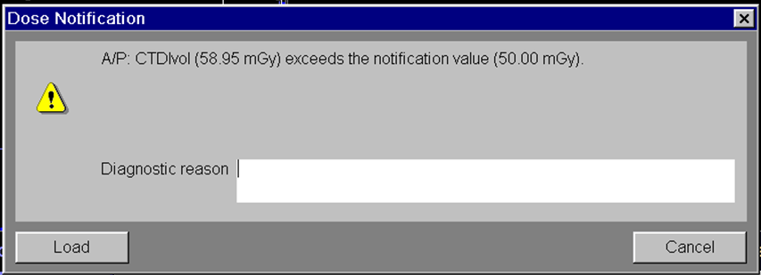
Dose Notification
When the scan protocol is confirmed (e.g. “go”, “load” or “confirm” buttons are selected), a message box will pop up:
Entering a reason is optional (e.g. very large patient)
This information will be stored in a text file for site review
Manufacturer should provide training on how to access these data
Example from Siemens scanner

Slide 6
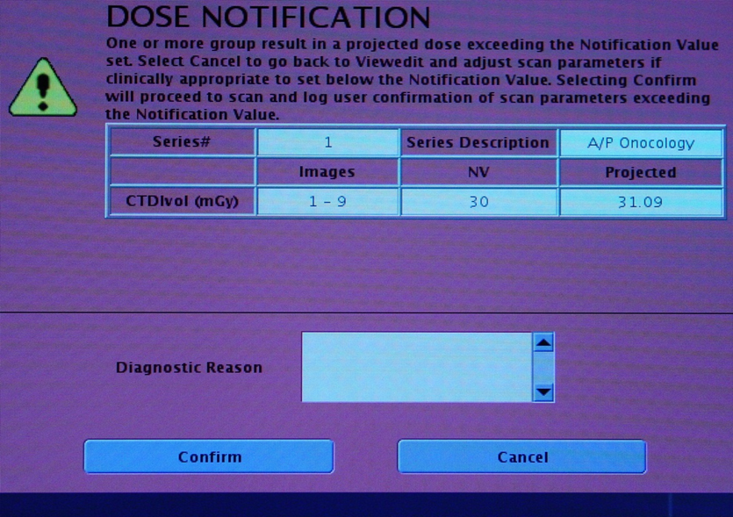
Dose Notification Pop-up Window Examples
GE

Slide 7
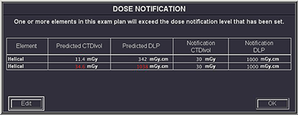
Dose Notification Pop-up Window Examples
Toshiba

Slide 8
Log files may include
time
date
patient ID
study ID
event type
series description
operator name
operator-provided reason for event
did operator use password
CTDIvol value that triggered notification event
programmed notification value (CTDIvol)
DLP value that triggered notification event
programmed notification value (DLP)

Slide 9
Dose Alert Values
Used to trigger a message when the cumulative dose at a location, plus the dose for the next planned and confirmed scan(s), is likely to exceed a pre-programmed value.
Programmed value is set once and applies to all exams (some systems may have adult and pediatric settings)
It is a scanner-wide parameter, not a protocol or sequence-specific parameter
FDA-recommend default value is CTDIvol=1000 mGy

Slide 10
Dose Alert
When a programmed scan(s) is confirmed (e.g. the go, load, or confirm button is pressed) that will result in the cumulative CTDIvol at any scan location exceeding the configured alert value (CTDIvol and/or DLP), a dose alert message box pops up
User name is mandatory
Example from Siemens scanner

Slide 11
Dose Alert
Password protection can be set
Example from Siemens scanner

Slide 12
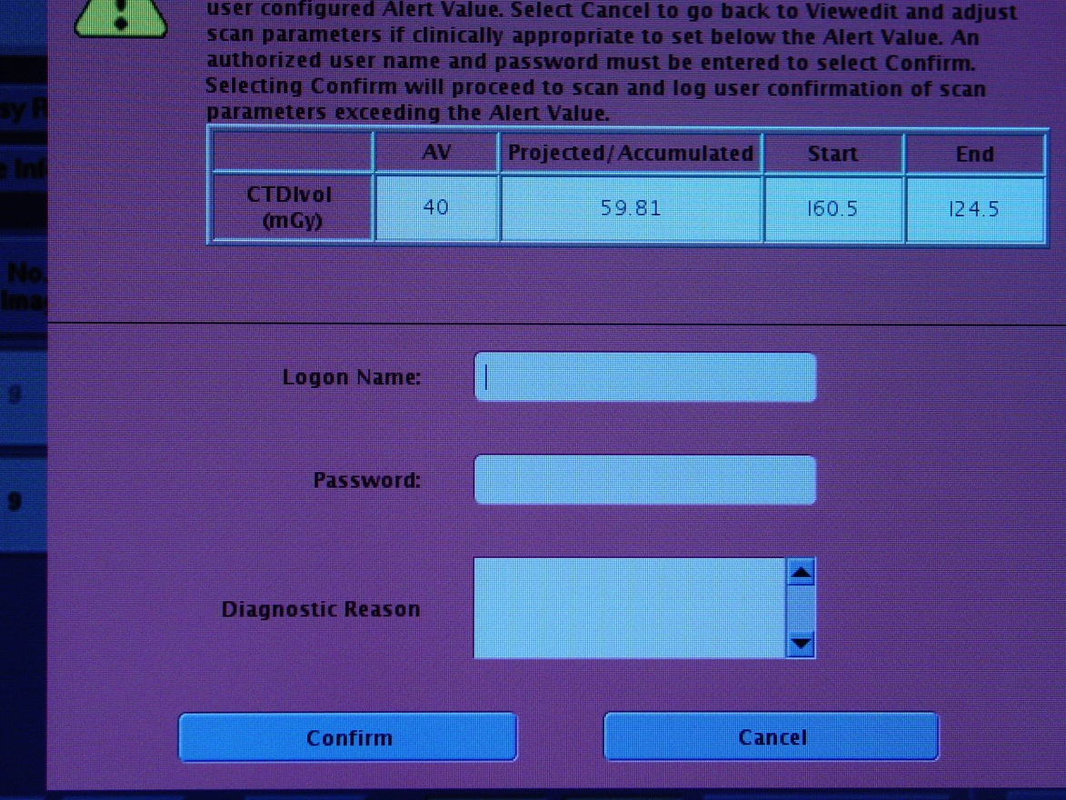
Dose Alert Pop-up Window Examples
GE

Slide 13
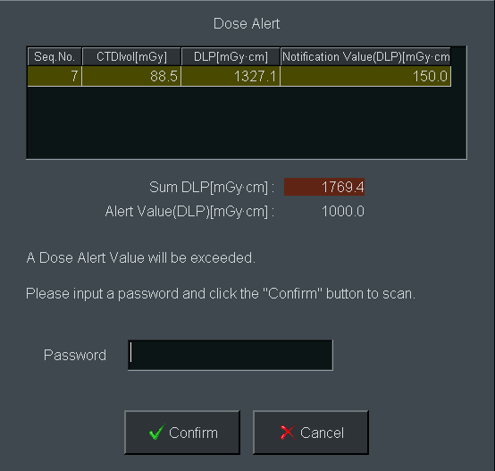
Dose Alert Pop-up Window Examples
Hitachi

Slide 14
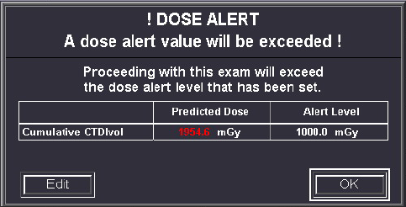
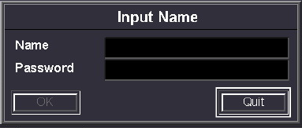
Dose Alert Pop-up Window Examples
Toshiba

Slide 15
Take Home Message
Automated evaluation of CTDIvol and/or DLP before patient scanning using the “Dose Check” feature can help protect patients from inadvertent use of excessively high CTDIvol and/or DLP
Does not negatively impact clinical workflow*
It was designed to prevent egregious errors
It was not designed to “optimize” dose
Sites must regularly monitor event logs
Use information to evaluate appropriateness of notification values and protocol parameters
Log monitoring is labor intensive
Tools from manufacturers are requested to facilitate log review
* Howard, ME et al., Use of CT Dose Notification and Alert Values in Routine Clinical Practice, JACR, March 2014

Slide 16
Important Operational Points
Standard operating procedures need to be established by a practice to ensure that dose check features are used effectively
Must have clear directions as to who is responsible for
Choosing and programming notification values
Log collection and evaluation
Modifying notification and alert values, as needed
Ensuring passwords are known only by chosen personnel
Giving approval to proceed with an exam after an alert

Slide 17
Important Operational Points
Practices must establish
Frequency of log collection and evaluation
Procedures for reviewing log data with practice leadership
Clear instructions for how technologists are to respond to notification events
Clear instructions for how technologists are to respond to alert events
Clear instructions for how technologists are to deal with an alert event during an interventional procedure
Guidelines for minimizing the impact of dose notifications and alerts on workflow (e.g. limiting the programmed number of bolus tracking scans to a reasonable number)

Slide 18
Example: Dose Notification Procedure
If a dose notification box appears, the prescribed dose for that specific scan exceeds a programmed dose notification value
Compare scanning parameters (mAs, kV, detector configuration, etc.) against the prescribed protocol to ensure nothing has been inappropriately entered
If scanning parameters are correct:
If patient size (measured at level of the liver) is greater than 45 cm, then in the space provided for a diagnostic reason enter “patient size is ___ cm” and proceed with scan
If patient size is smaller than 45 cm, call the lead technologist for guidance before proceeding

Slide 19
Example: Dose Alert Procedure
If a dose alert box appears, the prescribed accumulated dose for the entire exam exceeds the programmed dose alert value
Compare scanning parameters (mAs, kV, detector configuration, etc.) against the prescribed protocol to ensure nothing has been inappropriately entered
If the scanning parameters all appear correct, and exam or procedure must be performed without delay, proceed with scan. Otherwise,
Call on-site physicist*, supervising radiologist and/or a lead technologist immediately for guidance
He/she/they will review scanning parameters and patient information, and will approve proceeding with the exam if parameters are appropriate for the specific patient, indication, and diagnostic question
*If applicable to practice

Slide 20
Practical Advice – Operator Education
Operator education is ESSENTIAL
Be absolutely clear that these values are NOT limits.
If patient is large, the higher CTDIvol and DLP may be necessary to achieve adequate image quality, and the operator can proceed with confidence
Notification events simply draw attention to a potentially “high” exposure so that users can confirm that settings are appropriate

Slide 21
Practical Advice – Operator Education
If password is set, it must be known by at least one readily available person at all times
Do not turn on the feature until all operators are educated on how to respond, especially how to override an Alert during an interventional procedure
A medically critical scan must always be able to proceed

Slide 22
Dose Alert and Interventional Procedures
Interventional CT procedures often require repeated CT scans and may result in dose metrics that are substantially larger than those from diagnostic studies
The reported cumulative CTDIvol and/or DLP from these studies may exceed the default or user-specified dose alert level

Slide 23
Dose Alert and Interventional Procedures
When the cumulative CTDIvol for a study exceeds the dose alert level, the scan can not be performed until the alert is addressed
Operator must enter his/her name
Practices should determine whether a reason for proceeding should be entered. Using common terminology (e.g. obese patient, needed to repeat scan due to patient movement) will make log evaluations much more useful
Practices should determine if use of the password feature is desired, and if secondary approval is required (by whom)
If password is required, practice must have a fail-safe method of ensuring operator can obtain password when needed

Slide 24
Dose Alert and Interventional Procedures
The time spent addressing the alert may have serious consequences if alert occurs during a critical portion of an interventional procedure
Each scan confirmed after the initial alert may also need to be addressed, potentially causing multiple delays and impeding workflow
Interruption of the procedure by the dose alert has the potential to negatively affect the procedure safety or success, especially in complex procedures

Slide 25
Dose Alert and Interventional Procedures
If Dose Alert is enabled on a CT scanner that is used for interventional procedures, there are a number of steps an institution may take to ensure that the clinical workflow is not impeded
Ensure that the password to override the dose alert is available to all CT operators
Increase the Dose Alert level (e.g. to 2000 mGy)
2000 mGy is the maximum value allowed, and this may not be high enough in extremely complex cases
Turn off Dose Alert during interventional procedures
Turn off the Dose Alert feature completely

Slide 26
How to Turn Off Dose Alerts
Find the place where the dose alert value can be configured. This is likely in a system configuration or dose management section of the user interface.
Dose Alerts can be disabled by
Selecting the option to “Turn Dose Alert Off”
Deleting the numerical value (e.g. 1000 mGy) and leaving the box empty (the Dose Check standard does not require a system to display an alert if the alert value has not been set)
Replacing the numerical value (e.g. 1000 mGy) with 0 mGy (system response to a 0 value may be manufacturer dependent)
Manufacturers should specify the behavior of their systems
Users should also test and confirm this behavior

Slide 27
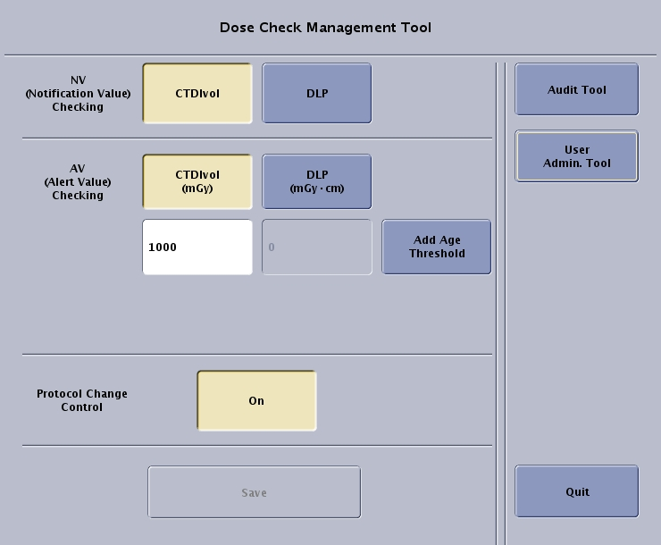
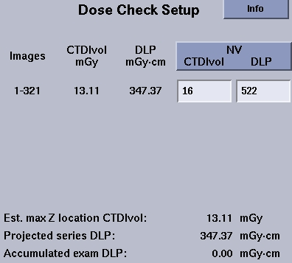
Configuration of Dose Check Values
GE

Slide 28
Caution
If a practice chooses to turn off Dose Alert only during interventional procedures, it is imperative a method to confirm the On or Off state is established and followed by all operators
Must remember to turn Dose Alert OFF before starting procedure
Must remember to turn Dose Alert ON after procedure is completed

Slide 29
CTDIvol vs. Skin Dose
CTDIvol is not the same thing as skin dose
The relationship between CTDIvol and skin dose depends on patient size and scan mode
Axial or helical scans (i.e. the table moves)
Head scans: Skin dose* is approximately equal to CTDIvol
Body scans: Skin dose* is approximately 20% greater than CTDIvol
Biopsy, fluoroscopy or perfusion scans (i.e. the table does not move during scanning)
Head scans: Skin dose* is approximately 50% of CTDIvol
Body scans: Skin dose* is approximately 60% of CTDIvol
*From Bauhs et al., CT Dosimetry: Comparison of Measurement Techniques and Devices, RadioGraphics, 2008; 28:245-253

Slide 30
CTDIvol Values where Risk of Skin Injury Starts
At skin doses of approximately 2000 mGy, transient skin erythema may begin to occur. This corresponds to …
Axial or helical scans (i.e. the table moves)
Head scans: CTDIvol* approximately equal to 2000 mGy
Body scans: CTDIvol* approximately equal to 1670 mGy
Biopsy, fluoroscopy or perfusion scans (i.e. the table dose not move during scanning)
Head scans: CTDIvol* approximately equal to 4000 mGy
Body scans: CTDIvol* approximately equal to 3330 mGy
*From Bauhs et al., CT Dosimetry: Comparison of Measurement Techniques and Devices, RadioGraphics, 2008; 28:245-253

Slide 31
Medical Context is Important
In only a very few situations is a cumulative CTDIvol > 2000 mGy observed.
Examples of important medical procedures where these high CTDIvol values are observed include:
Cryoablation and RF ablation procedures
Cementoplasty or multi-level blood patches for CSF leaks
These procedures are often performed for oncological or other serious medical conditions, and offer important medical benefits that outweigh the low risk of transient skin erythema or hair loss
Dose Alerts should not stop a needed procedure

