Slide 1
Risk in Medical Imaging: Separating Fact from Fantasy
William Hendee, PhD

Slide 2
With thanks to
Michael O’Connor, PhD
Professor of Radiology
Mayo Clinic

Slide 3
NO CONFLICTS OF INTEREST
TO DECLARE –
FINANCIAL OR OTHERWISE
© WRH (Nov., 2011)

Slide 4
What I Believe In
ALARA – Doses As Low As Reasonably Achievable
ASARA – Procedures As Safe As Reasonably Achievable
AHARA – Benefits As High As Reasonably Achievable
© WRH (Nov., 2011)

Slide 5
Radiation Exposure to US Population from all Sources
US 1982 (NCRP 93)
US 2006 (NCRP 160)
Medical 0.54 mSv per capita
Total 3.6 mSv per capita
Medical 3.0 mSv per capita
Total 6.2 mSv per capita
NCRP 160 published March 2009

Slide 6
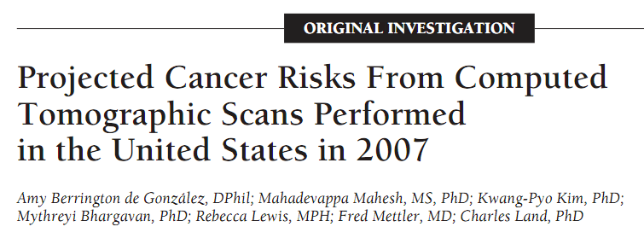
Estimates that 29,000 future cancers and 14,500 deaths are related
to CT scans performed in the U.S. in 2007.
Arch Intern Med. 2009;169(22):2078-2086
© WRH (Nov., 2011)

Slide 7
Estimates one in 270 women (1 in 600 men) who undergo CT coronary angiography will develop cancer from the CT scan.
Arch Intern Med. 2009;169(22):2078-2086
© WRH (Nov., 2011)

Slide 8
Computed Tomography — An Increasing Source of Radiation Exposure
David J. Brenner, Ph.D., D.Sc., and Eric J. Hall, D.Phil., D.Sc. N Engl J Med 2007; 357:2277-2284, November 29, 2007
1.5 – 2 % all cancers in United States caused by CT exams
© WRH (Nov., 2011)

Slide 9
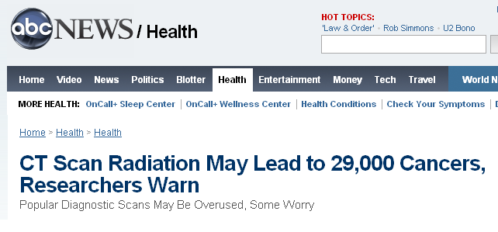

Slide 10
What is the origin of these estimates of cancer incidence and death from
medical imaging?
[Small “estimated” cancer risk]
Multiplied by
[Large patient population]
Yields
[Many hypothetical cancers]
© WRH (Nov., 2011)

Slide 11
Sources of Data on Human Radiation Effects
RERF study of A-bomb survivors
Occupational radiation studies
Environmental radiation studies
Populations near nuclear facilities
Populations near A-bomb tests
TMI and Chernobyl
Natural background studies
Medically-exposed populations
© WRH (Nov., 2011)

Slide 12
Comparison of A-bomb Survivors to Medically-Exposed Persons
Radiation LET
Instantaneous whole-body exposures
Additional health threats
Additional health factors
Absence of medical care
© WRH (Nov., 2011)

Slide 14
LNT Model of Low-Dose Radiation Injury
Introduced by Hermann Muller in 1920s for
genetic effects of x rays
Used in 1956 by BEIR 1 for genetic effects
of radiation
Later adopted for cancer risk
Intended for radiation protection standards
© WRH (Nov., 2011)

Slide 15
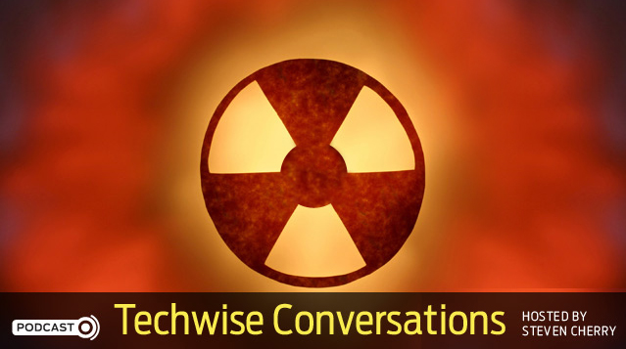
Did a Nobel Laureate knowingly lie about the dangers of radiation in 1946?
An interview of Edward Calabrese,
Professor of Toxicology and Pharmacology
University of Massachusetts
IEEE Spectrum
October 7, 2011
© WRH (Nov., 2011)

Slide 16
The Linear No-Threshold Relationship is Inconsistent with Radiation Biologic and Experimental Data
Maurice Tubiana, Ludwig E. Feinendegen, Cichuan Yang, Joseph M. Kaminski
Among humans, there is no evidence of a carcinogenic effect for acute irradiation at doses less than 100 mSv and for protracted irradiation at
doses less than 500 mSv
The fears associated with the concept of LNT and the idea that any dose,
even the smallest, is carcinogenic lack scientific justification
Radiology April 2009;169 251:13-22
© WRH (Nov., 2011)

Slide 17
Preston et al, Table 4, Rad. Res. 2007; 168: 1-64.
(Courtesy of M. O’Connor, Mayo Clinic)

Slide 18
Adult Effective Doses for Various CT Procedures
Examination | Effective dose (mSv) | Range in literature (mSv)
Head | 2 | 0.9 – 4.0
Neck | 3 | …
Chest | 7 | 4.0 – 18.0
Chest for Pulmonary Embolism | 15 | 13 – 40
Abdomen | 8 | 3.5 – 25
Pelvis | 6 | 3.3 – 10
Three-phase liver study | 15 | …
Spine | 6 | 1.5 – 10
Coronary angiography | 16 | 5.0 – 32
Calcium scoring | 3 | 1.0 – 12
Virtual colonoscopy | 10 | 4.0 – 13.2
Mettler FA, et al., Radiology, 248(1), 254-263, 2008

Slide 19
Effective Dose: Recommendations of the ICRP. Publication 103 (2007)
Effective dose is intended for use as a protection quantity. The main uses of effective dose are the prospective dose assessment for planning and optimization in radiological protection, and demonstration of compliance with dose limits for regulatory purposes. Effective dose is not recommended for epidemiological evaluations, nor should it be used for detailed specific retrospective investigations of individual exposure and risk.
© WRH (Nov., 2011)

Slide 20
(Lifetime Attributable) Risk Estimates
BEIR VII – Biological Effects of Ionizing Radiation
Report VII of the US National Academy of Sciences
© WRH (Nov., 2011)

Slide 21
…range of plausible values for LAR is labeled a “subjective confidence interval” to emphasize its dependence on opinions in addition to direct numerical observation (BEIR VII, page 278)

Slide 22
Risk Models
Lifetime Attributable Risk (LAR)
“Because of the various sources of uncertainty it is important to regard specific estimates of LAR with a healthy skepticism, placing more faith in a range of possible values” (BEIR VII, page 278)
So how valid is the 5%/Sv factor commonly used to estimate cancer risk?
© WRH (Nov., 2011)

Slide 23
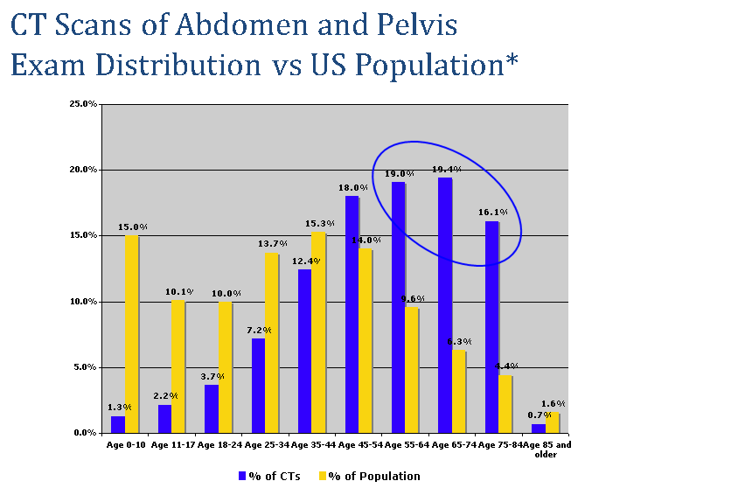
~20% of population >55 years, receives >55% of CT scans

Slide 24
Health Physics Society Position
Recommends against quantitative estimation of health risks below an individual dose of 5 rem (50 mSv) in one year or a lifetime dose of 10 rem (100 mSv) above that received from natural sources
For doses below 5-10 rem (50-100 mSv) risks of health effects are either too small to be observed or are nonexistent
Richard J. Vetter, PhD

Slide 25
Radiation-Induced Cancers in Population
Impossible to detect at doses
<100 mSv
May be addressable in future by
New pathology criteria
Patient registries
Understanding cellular/molecular processes
Studies of sensitive sub-populations
© WRH (Nov., 2011)

Slide 26
Radiation-Induced Cancers in Population
No solid supporting data
Predictions highly suspect
Media attention
Public anxiety
Health effects of refused exams
© WRH (Nov., 2011)

Slide 27
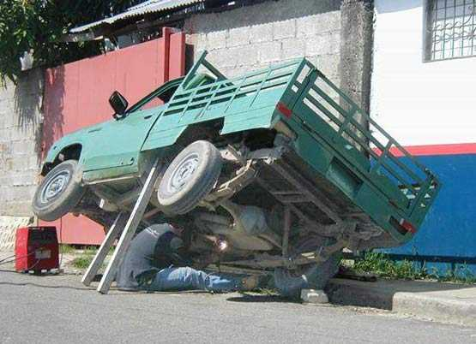
Perception of Risk vs. Benefit
Richard J. Vetter, PhD

